Slide 1
Good safeguarding measures
IMP 5.10
UNESCO
Intangible Cultural Heritage Section

Slide 2
In this presentation...
Safeguarding defined and discussed
Kinds of safeguarding measures
Addressing threats and risks to viability
Safeguarding plans
Examples of good safeguarding measures

Slide 3
The Convention for safeguarding
States Parties shall ‘take the necessary measures to ensure the safeguarding of the intangible cultural heritage present in [their] territory’ (Article 11(a))
Article 18 - Register of best safeguarding practices (see also OD 3 to 7 and 42 to 46)
Article 17 - Urgent Safeguarding List (USL)
Priority assistance from the ICH Fund given to elements on the USL (Article 20, OD 9(a))

Slide 4
Safeguarding defined
Safeguarding means ensuring the viability of ICH (Article 2.3).
Safeguarding measures are actions taken to promote the viability of the element (examples in Article 2.3).

Slide 5
‘The necessary measures’ for safeguarding
Not all ICH elements can be safeguarded.
The Convention provides for both general and specific safeguarding measures.

Slide 6
General measures for safeguarding
Art. 11(b): identify and define the ICH
Art. 12: inventory the ICH
Art. 13: adopt general policies; designate or establish competent bodies; foster studies; adopt appropriate legal, technical, administrative and financial measures;
Art. 14: ensure recognition of, respect for and enhancement of the ICH in society; and
Art. 15: ensure the participation of communities in safeguarding activities and involve them in the management of their ICH.

Slide 7
Specific measures for safeguarding specific elements
Identification
Inventorying
Documentation
Research
Revitalization
Protecting related places and materials
Encouraging transmission through education
Awareness-raising
See Articles 2.3, 12, 13, 14.
With community participation and consent :

Slide 8
Examples of safeguarding measures
General measures:
Creating an enabling legal and administrative environment for safeguarding
Raising awareness about the value of ICH
Identifying and inventorying the ICH
Specific measures:
Identifying, researching and documenting specific ICH elements
Supporting continued enactment and transmission of the elements

Slide 9
Safeguarding of vibrant ICH elements
Vibrant ICH elements may not require specific measures for safeguarding to ensure continued practice and transmission.
Continued practice and transmission may be encouraged through general measures.

Slide 10
Safeguarding vs. conservation: the Ahayu:da case study
J. Hillers, Zuni war gods, 1880
www.metmuseum.org
Notes:
http://www.metmuseum.org/works_of_art/collection_database/all/zuni_war_gods_john_hillers/objectview_enlarge.aspx?page=14154&sort=0&sortdir=asc&keyword=&fp=1&dd1=0&dd2=0&vw=1&collID=0&OID=190019135&vT=1&hi=0&ov=0
The Materials are made available for limited non-commercial, educational, and personal use only, or for fair use as defined in the United States copyright laws. John Hillers (American, born Germany, 1843–1925), Zuñi War Gods (1880)

Slide 11
Addressing threats and risks
Safeguarding measures address threats and/or risks to the viability of the ICH
See Articles 11(a), 14(b), OD 1, 2 and 7.

Slide 12
The Voladores ceremony (Mexico)
© 2008, by Cumbre Tajin
Notes:
http://www.unesco.org/culture/ich/index.php?lg=en&pg=00011&RL=00175

Slide 13
Threats to viability - 1
The flight of the Voladores around the pole is the climax of the ceremony.
Increasingly only this part of the ceremony is performed, for tourists, outside the community context
© 2008, by Cumbre Tajin
Notes:
http://www.unesco.org/culture/ich/index.php?lg=en&pg=00011&RL=00175

Slide 14
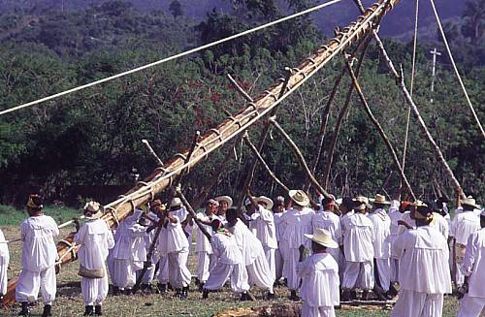
Threats to viability - 2
Poles for the ceremony were traditionally cut down in the forest and ritually prepared.
Too few appropriate trees, now using fixed metal poles
© 2008, by Cumbre Tajin
Notes:
http://www.unesco.org/culture/ich/index.php?lg=en&pg=00011&RL=00175

Slide 15
Threats to viability - 3
Ritual preparations for the ceremony maintain its significance for the community.
Performance by professional dancers reduces focus on ritual aspects.
© 2008, by Cumbre Tajin
Notes:
http://www.unesco.org/culture/ich/index.php?lg=en&pg=00011&RL=00175

Slide 16
Voladores safeguarding measures
Meetings with Voladores groups; State and NGO support
Measures include:
Reforestation
Opportunities for performing the entire ceremony including ritual dimensions
Schools for Volador Children promoting transmission of knowledge & skills including ritual dimensions

Slide 17
Safeguarding with communities concerned
Ensure community participation (Art.15)
Assess viability, threats and risks
Assess commitments, opportunities, available funds
Identify other partners
Study previous interventions
Determine safeguarding measures, their order and relative importance
Do monitoring and evaluation

Slide 18
Safeguarding plans
Activity | Stakeholders | Timetable | Cost/ Needs | Outcomes expected

Slide 19
Batik (Indonesia)
Children learning batik-making (c) 2008 Batik Museum Institute Pekalongan
Notes:
http://www.unesco.org/culture/ich/index.php?RL=00170

Slide 20
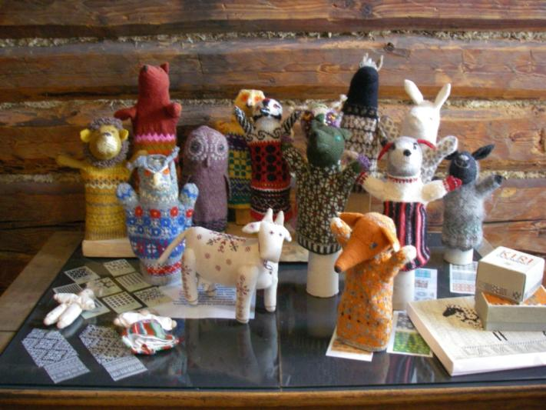
Anu Raud’s school and museum (Estonia)
New knitted items made using the patterns
Part of the pattern documentation collection
Notes:
Photos taken by Harriet Deacon – UNESCO is free to use them

Slide 21
Living human treasures: Philippines case study
Uwang Ahadas, a Filipino Living Treasure teaching and transmitting gabbang
©R.S. Rastrollo
Notes:
Uwang Ahadas, a Filipino Living Treasure teaching and transmitting gabbang
©R.S. Rastrollo http://www.unesco.org/culture/ich/index.php?pg=00311&cp=PH&topic=lht#a-acronym-titleliving-human-treasurelhtacronym-system

Slide 22
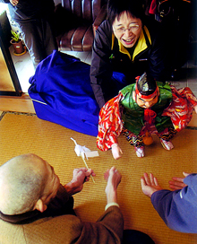
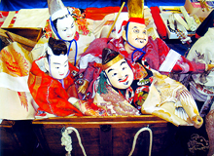
Case study: Sanbasomawashi (Japan)
Sanbasomawashi (c) 2007 ACCU
Notes:
http://www.accu.or.jp/ich/en/community/sanbaso.html

Slide 23
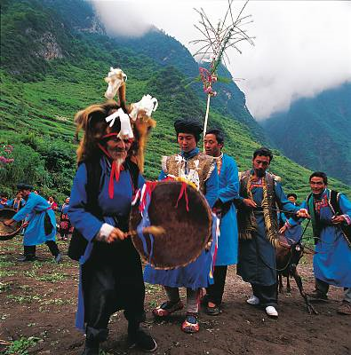
Case study: Qiang New Year festival (China)
Community members celebrating the festival (c) 2005 Wan Yuchan
Notes:
(c) 2005 Wan Yuchan http://www.unesco.org/culture/ich/index.php?lg=en&pg=00011&USL=00305

Slide 24
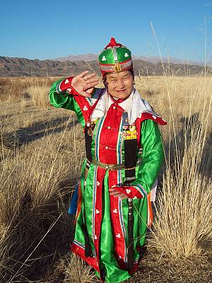
Case study: Mongolian Traditional Folk Dance
© 2008 A. Duurenjargal
Notes:
http://www.unesco.org/culture/ich/index.php?lg=en&pg=00011&USL=00311

